Slide 1
Finding Maternal Risk Factors for Low-Birth Weight Delivery Using Machine Learning
GROUP-12
Shameema Afrin Jahir Husain
Shwetha Srinivasan Natesan
Aniritha Tharun Krishnakanth

Slide 2
Abstract
Introduction:
To determine the term Low Birth Weight (LBW) rate and the incidence of certain risk factors.
Methods:
This study implemented predictive LBW models. The study was employed to compare and identify the best-suited classifier for predictive classification among Logistic Regression, bagged-tree, and Random Forest (RF).

Slide 3
Questions on Focus
Q1
Q1) What is the most important factor influencing the low birth rate?
Q2
Q2) Which ML classifier is most appropriate for predictive classification among Generalized Linear Models & Nonlinear Models?
Q3
Q3) What are the methods for lowering regression error?
Q4
Q4)What is the conclusion of having a high-risk factor?

Slide 4
Data Exploration
Variable That is dependent :
LOW: Low birth weight
BWT: Actual Infant birth weight
The variable that is Independent:
AGE: The age of the mother
LWT: Mothers Weight at last
RACE: 1 = White, 2 = Black, 3 = Other
SMOKE: Smoking status during pregnancy:1 = Yes, 0 = No
PTL: History of premature labor: 0 = None, 1 = One, 2 = two, 3 = three
HT: History of hypertension: 1 = Yes, 0 = No
UI: Uterine irritability: 1 = Yes, 0 = No
FTV: Number of physician visits in 1st trimester: 0 = None, 1 = One, … 6 = six

Slide 5
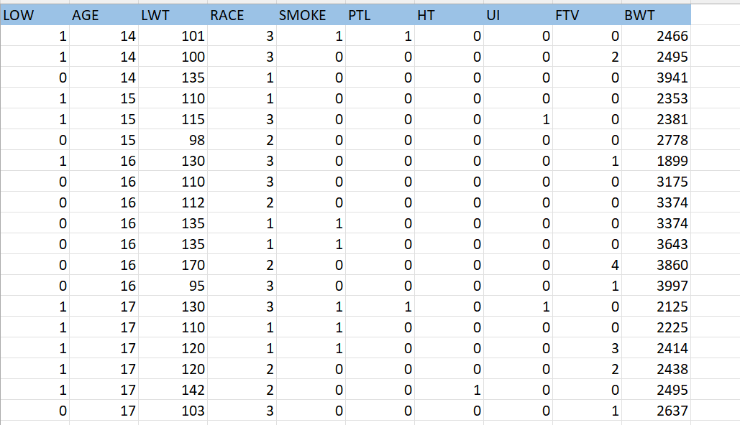
The dataset's "clean" version:

Slide 6
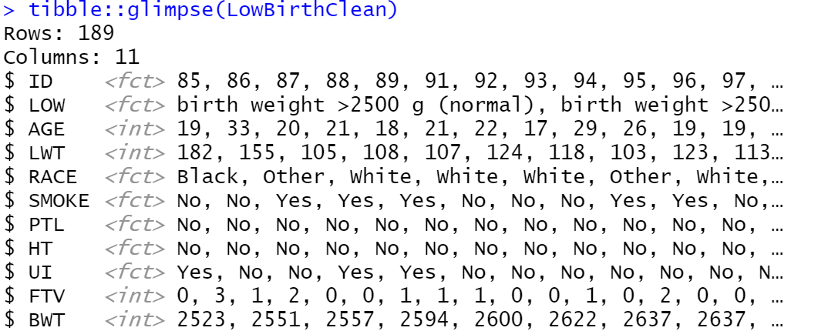
Logistic Regression
Logistic Regression is a method for fitting a regression curve y = f(x) where y is a categorical variable.
The function used is glm ( ).
The dataset is cleaned using the Tibble function.

Slide 7
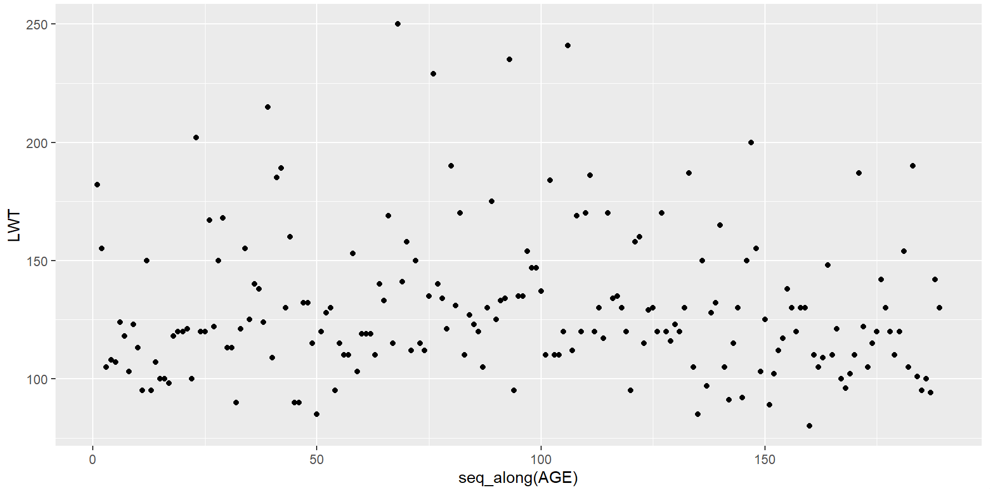
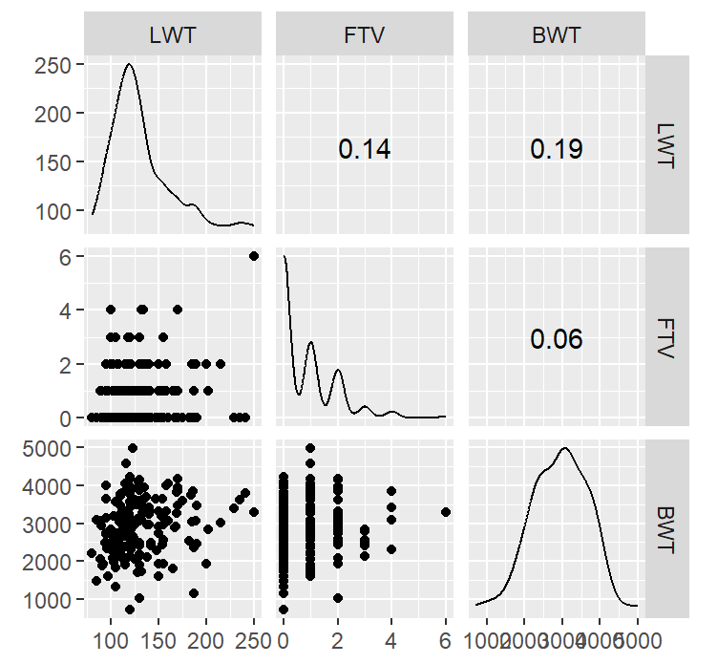
Scatter Plot
A combination of scatterplot and correlations are obtained by implementing GGally library and ggscatmat ( ) function and a simple ggplot to show the relation between Age and Low birth weight.

Slide 8
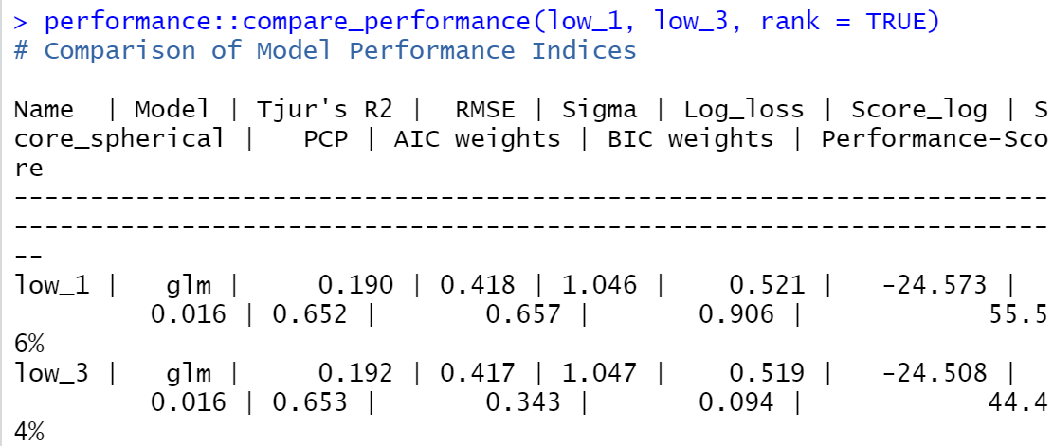
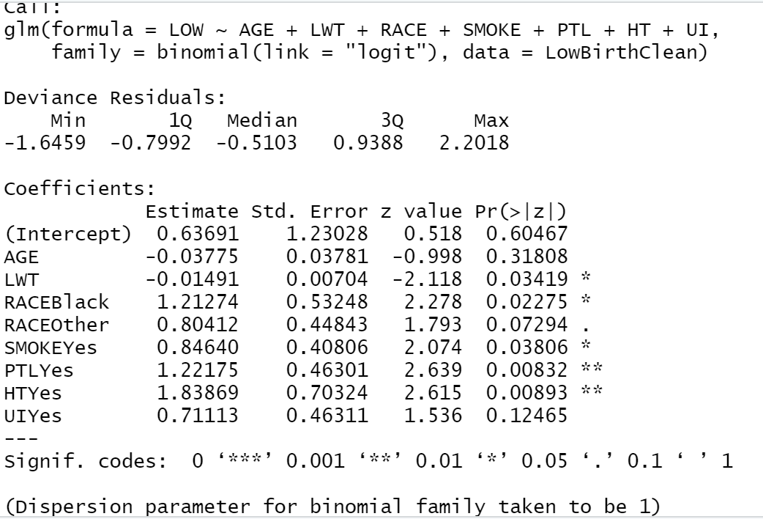
Logistic Regression for Simple models
A simple logistic regression for each of the variable is performed and the summary of each variable is obtained.
Using the performance function, comparison of two models are made and the efficiency is obtained.

Slide 9
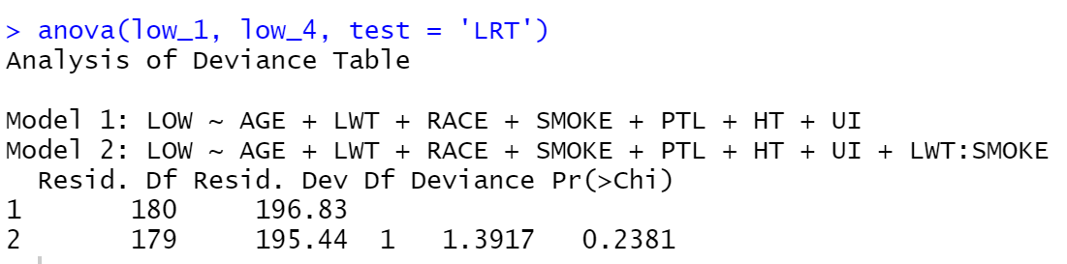
Logistic Regression for Multivariate models
Few Logistic comparisons are made with the main variables after removing the minor effects that don’t affect the birth rate much and then comparison is done between them.
Here the factors Age and Weight, Age and Smoking, Weight and Smoking are used, and the fit models are compared and tested using Likelihood Ratio Test.
As we can see here anova is used to test the level of changes between the original fit model and the model with Weight and Smoking.

Slide 10
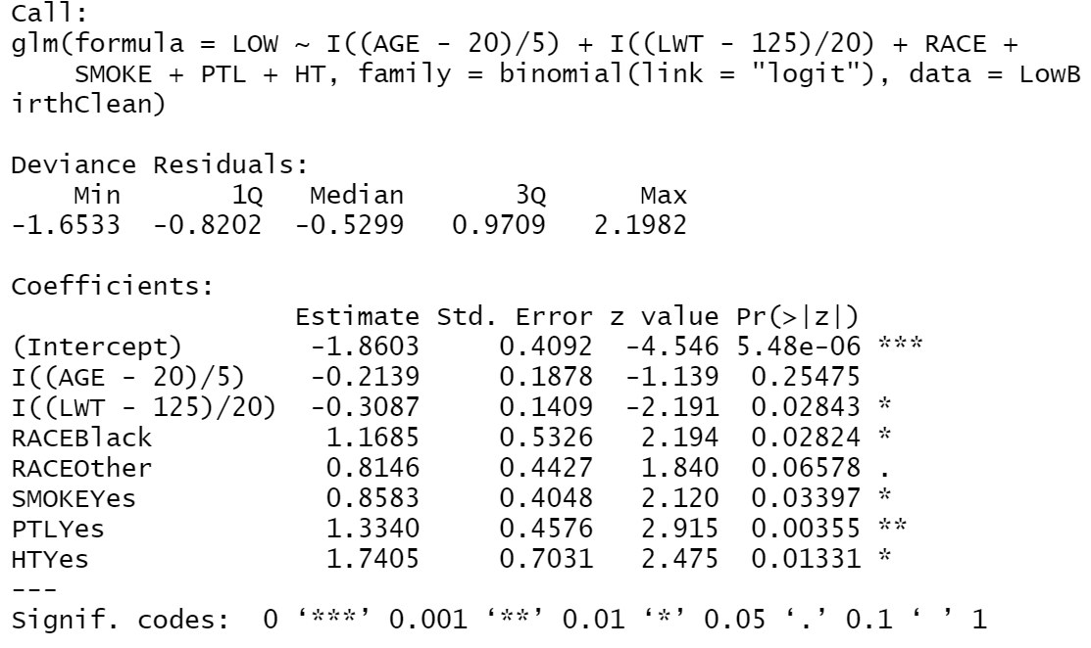
Logistic Regression for Final Model
After the analysis of single and multivariate fit models, it is clear that the mother’s age is a main factor and by using it we can estimate the other factors too.
So, a basic interpretation is done by keeping the age as 5 years and weight as 20 lbs.

Slide 11
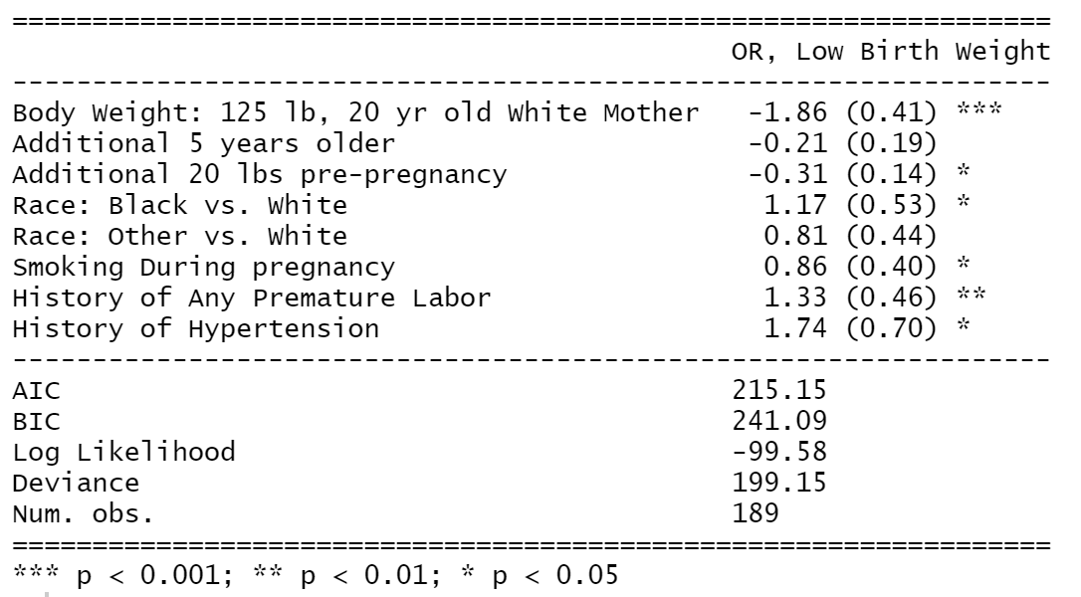
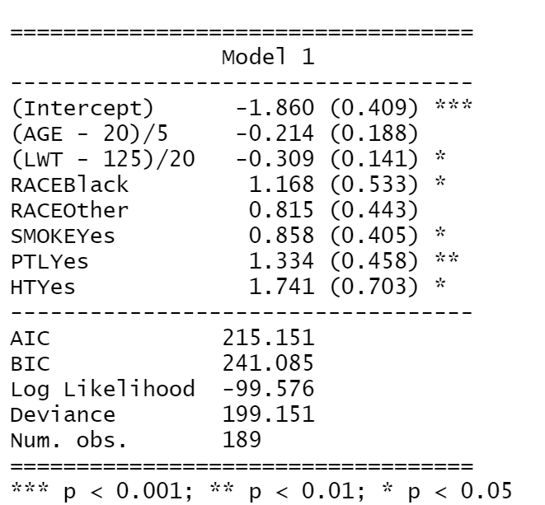
Parameters Estimates
The R package called texreg is used to estimate the individual parameters of the dataset and it contains a function called extract ( ) which extracts the information from the model and place them in the right place.

Slide 12
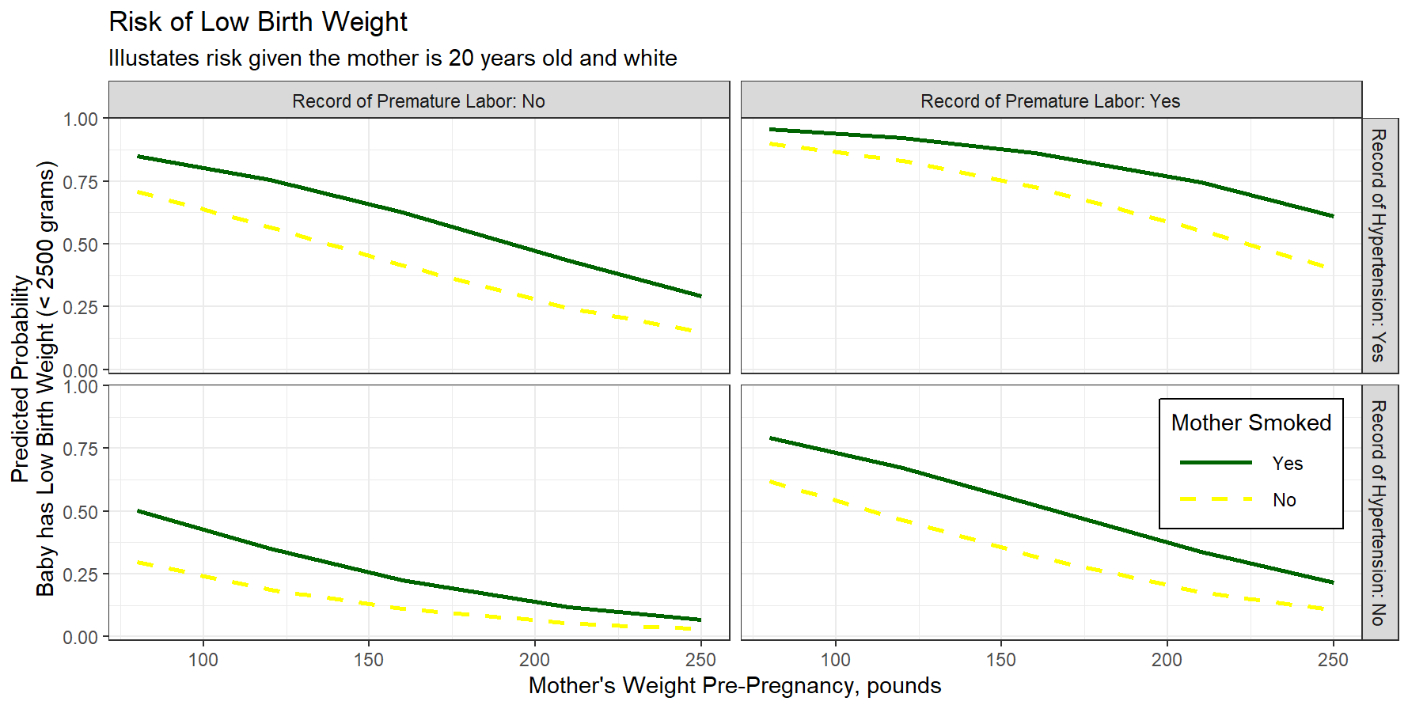
Plot focusing on Mother’s Weight and Smoking Habit
The function effect ( ) is used to show the relation between the Mother’s Weight and Smoking status along with premature labor and hypertension record.
From the model, the factors premature labor and hypertension are also one of the factors in affecting low birth weight.
The main factor would be smoking which is also a cause for premature labor and hypertension which leads to high risk of low birth rate.

Slide 13
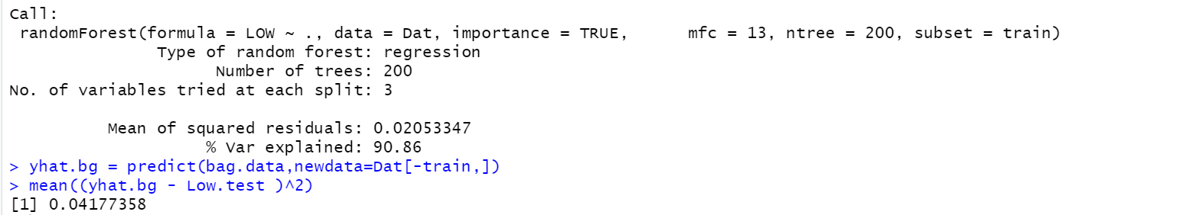
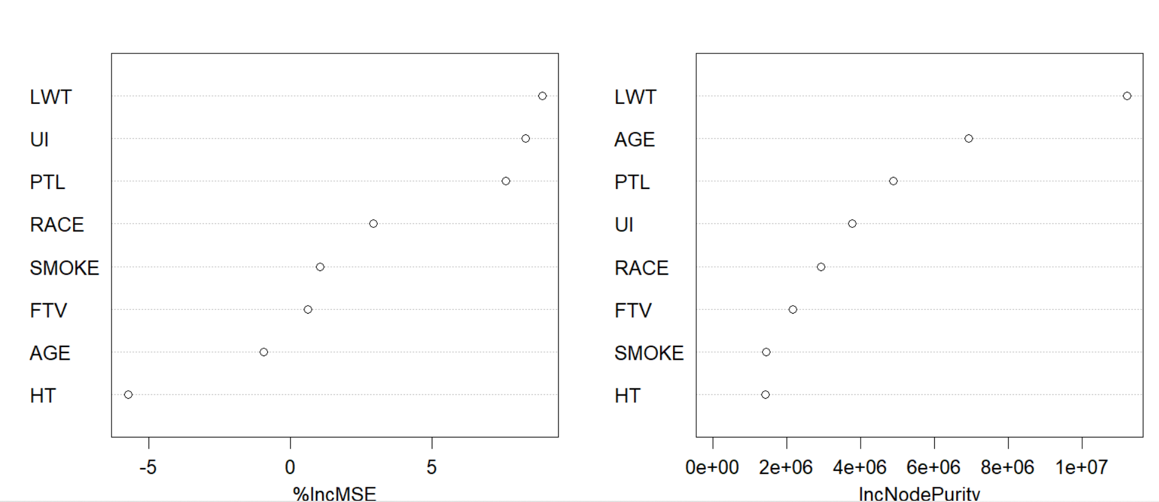
Create bagged trees by letting mtry=6. The default is to use 25 trees.

Slide 14
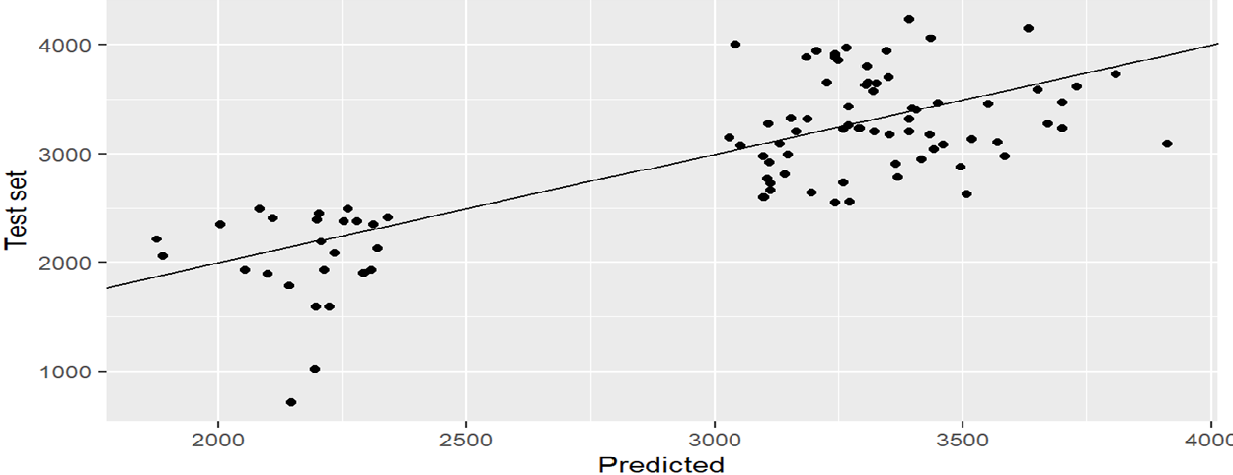
Test Vs Trained Result

Slide 15
Random Forest:
Processing Data/Cleaning
Feature selection
Data Classification
Training (70%)
Testing (20%)
Provide Classifiers
Test predicative
Tunning Model
Performance Analysis
Predict LBW

Slide 16
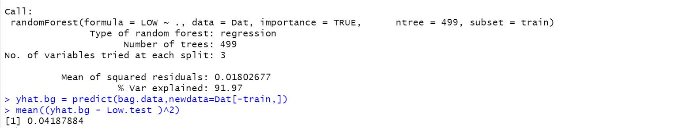
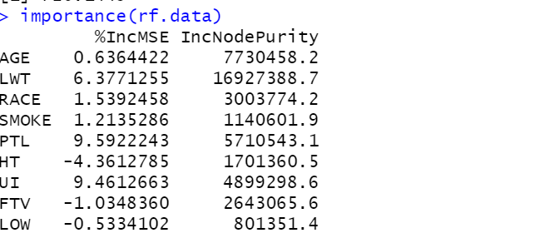
Tune the Model

Slide 17

From the results, we can see that the simulation that provided the lowest test mean squared error (MSE) utilized 499 trees. We can also see that the root mean squared error of that model was 0.018 and the test vs training result is 0.041. This can be thought of as the average difference between the expected and observed values for BWT.

Slide 18
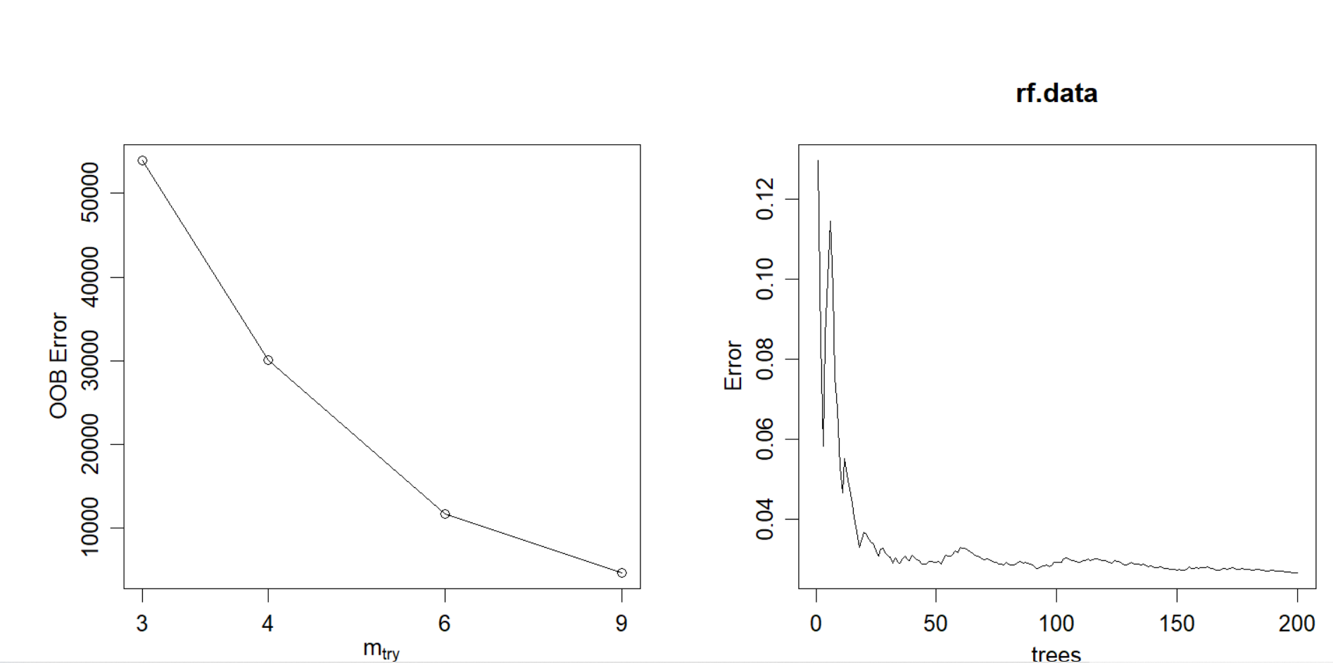
This function produces the following plot, which displays the number of predictors used at each split when building the trees on the x-axis and the out-of-bag estimated error on the y-axis:

Slide 19
Conclusion
Analyzing logistic regression, Bagged tree and Random Forest we could determine that the History of premature labour and the Mother’s Weight, are the very high-risk factor for Low-birth rates.
And we overcome the logistic regression’s difficulty of prediction using the p-value for each variable by bagged and Rf performance.
The Random Forest is the most accurate method compared to all the methods of regression. Because The MSE and mean difference of the Train and test got reduced even more to 0.018,0,041 from 0.020 and 0.041.

